Slide 1
Mapping the Educational Landscape
A Comprehensive Data Analytics Study of Engineering Colleges in India
Presented By :
BASANI RAKESH

Slide 2
CONTENTS :
Objective
Steps performed
Web scraping
Data cleaning & manipulation
Data visualization & insights
Dashboard
Conclusion

Slide 3
Objective :
The Ultimate goal of this project is to provide actionable insights to students , parents and policymakers in the Selection of Higher Education.
To analyze engineering colleges data across India to uncover engineering college across states, course availability, Fee Structure Analysis, and provide actionable insights that will help improve to select the right engineering college by students, parents and policymakers.
The data is taken from “CAREERS360” website by using Python [ Web Scraping ] .

Slide 4
Steps Performed :
Web Scraping
Data Cleaning & Manipulation
Data Visualization & Insights

Slide 5

Web Scraping
Web scraping is the process of using software to extract data from websites.
Here, from “CAREERS360” Website I have extracted data required to perform Analysis.
I have extracted 3 Tables,
1 Table contains College Name, Location, College Type, Rating, Total Reviews
2 Table contains College Name, Course Name, Seats, Fees,Seats1, Fees2
3 Table contains College Name, Available Facilities
1 table :
2 table :
3 table :

Slide 6
Data Cleaning and Manipulation
"Data Cleaning and Manipulation" refers to the process of identifying and correcting errors, inconsistencies, and formatting issues within a dataset to ensure its quality and reliability for analysis.
Here, The Data Cleaning is Performed used Pandas Library and also Power Query.
Manipulation includes adding Course Type columns, merging two column to one column, handling missing values, standardizing data types etc.
1 table :
2 table :
3 table :

Slide 7
Data Visualization
Data visualization is the graphical representation of information and data. By using visual elements like charts, graphs, and maps, data visualization tools provide an accessible way to see and understand trends, outliers, and patterns in data.
Microsoft Power BI is an interactive data visualization software product developed by Microsoft with a primary focus on Business Intelligence (BI).
Performed Visualization and Analysis on various factors like Fees, College based on Location,
Facilities etc. to analyze above problem statements

Slide 8
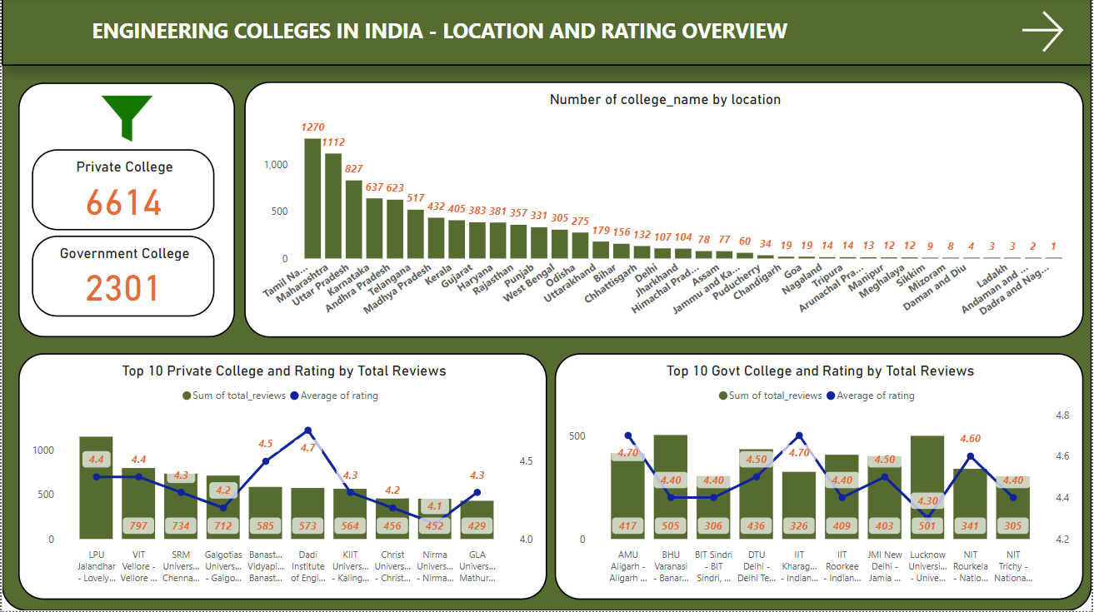
Dashboard

Slide 9
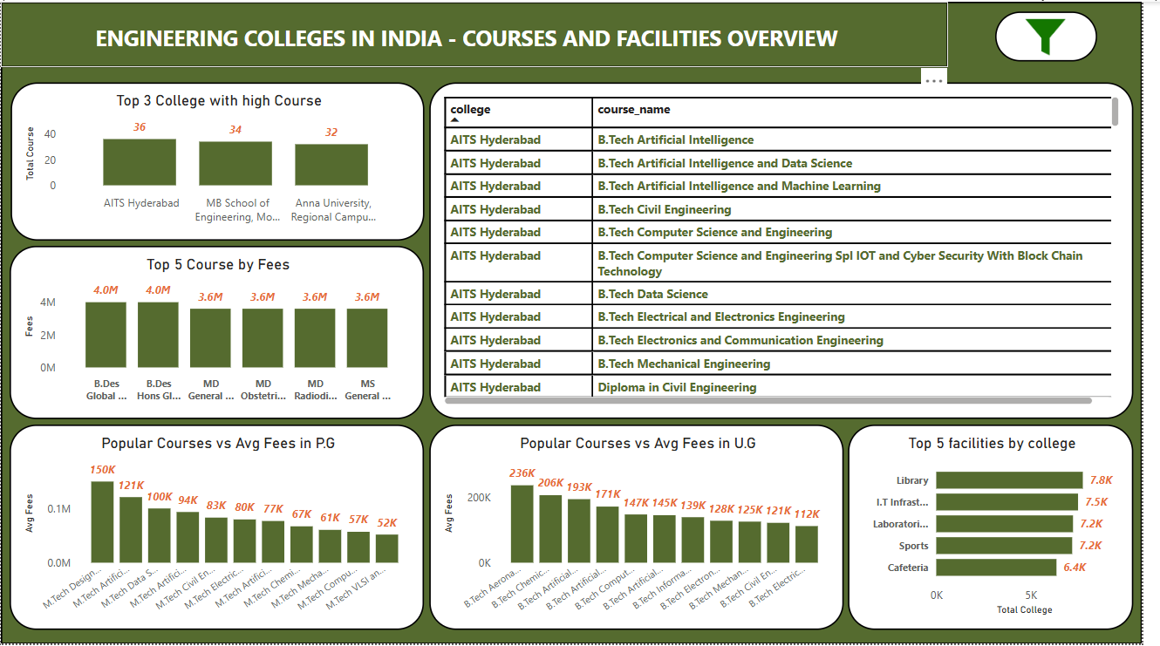

Slide 10
Conclusion :
TAMIL NADU have most college with 1270.
TAMIL NADU have most private college with 1122.
UTTAR PRADESH have most Government college with 213.
In Private college Lovely professional university, Punjab have most number of reviews with 1149 and Rating of 4.4
In Government college Banaras hindu University, Uttar Pradesh have most number of reviews with 505 and Rating of 4.4
B.Des Global Design hons course have highest Fees with 40 lakhs

Slide 11
Thank you

